Slide 1
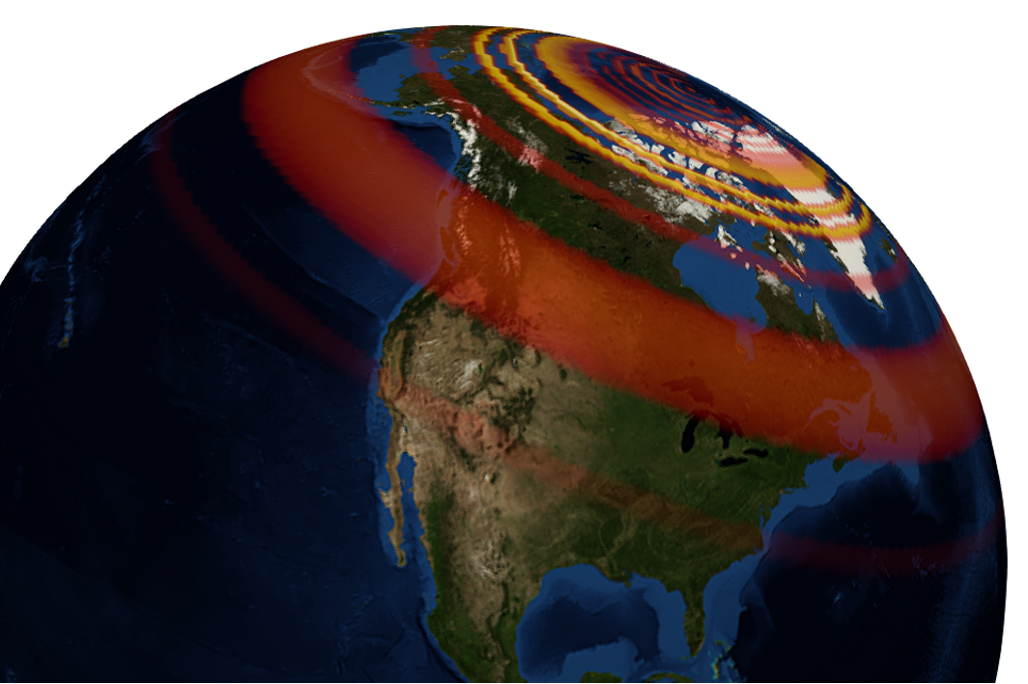
GEOL593: Seismology and Earth Structure, Spring 2023
Lecture 2: Seismic signal processing
1/24/23
Ross Maguire
rossrm@illinois.edu
3014 NHB

Slide 2
Class schedule
 | Dates | Topic | Lab assignment
Week 1: | Jan 17, Jan 19 | Course overview | Lab 1: Python crash course
Week 2: | Jan 24, Jan 26 | Seismic signal processing | Lab 2: Introduction to Obspy
Week 3: | Jan 31, Feb 2 | Moment Tensors/ Inverse methods | Lab 3: Moment tensor inversion
Week 4: | Feb 7, Feb 9 | Seismic wave propagation 1: Body waves | Lab 4: Reference Earth models: The “1D” Earth
Week 5: | Feb 14, Feb 16 | Seismic wave propagation 2: Surface waves | Lab 5: Surface wave dispersion
Week 6: | Feb 21, Feb 23 | Normal modes: Free oscillations of Earth | Lab 6: Tomographic inversion
Week 7: | Feb 28, Mar 2 | Imaging Earth Structure 1: Seismic tomography | Lab 7: Receiver functions
Week 8: | Mar 7, Mar 9 | Imaging Earth Structure 2: Seismic discontinuities | Research paper discussion
Week 9: |  | Spring break
Week 10: | Mar 21, Mar 23 | Anisotropy and anelasticity
Week 11: | Mar 28, Mar 30 | Planetary seismology 1 | Lab 8: InSight- Seismology on Mars
Week 12: | Apr 4, Apr 6 | Planetary seismology 2
Week 13: | Apr 11, Apr 13 | Machine learning in seismology 1 | Lab 9: Earthquake detection
Week 14: | Apr 18, Apr 20 | Machine learning in seismology 2
Week 15: | Apr 25, Apr 27 | Frontiers of seismology: What’s next?
Week 16: | May 2, May 4 | Research paper presentations

Slide 3
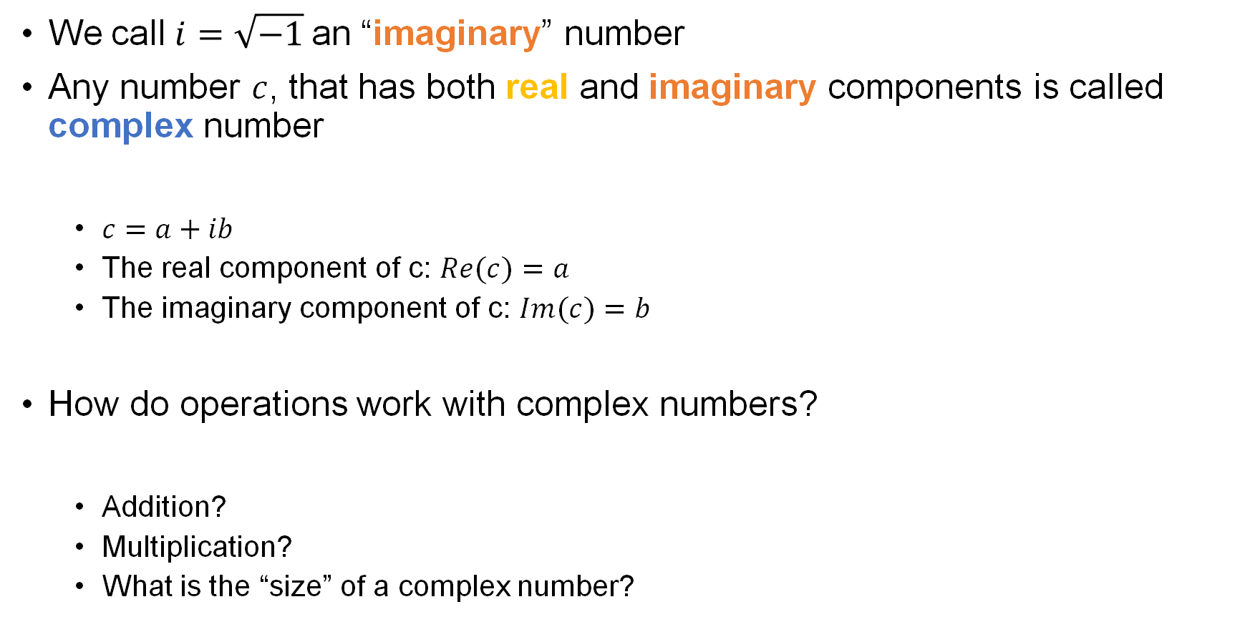
Review of complex numbers
We call $i=\sqrt{−1}$an “imaginary” number
Any number $c$, that has both real and imaginary components is called complex number
$c=a+ib$
The real component of c: $Re(c)=a$
The imaginary component of c: $Im(c)=b$
How do operations work with complex numbers?
Addition?
Multiplication?
What is the “size” of a complex number?

Slide 4
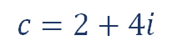
The complex plane
Im
6
$$c=2+4i$$
4
2
-6
-4
-2
0
2
4
6
Re
-2
-4
-6

Slide 5


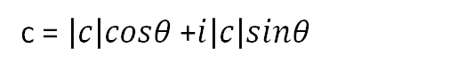
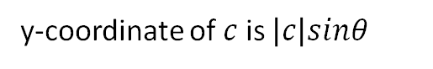
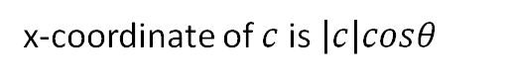

The complex plane
Im
$\left|c\right|$ = size/length of complex number, $\left|c\right|=\sqrt{a^{2}+b^{2}}$
6
$$c=2+4i$$
x-coordinate of $c$ is $\left|c\right|cosθ$
4
y-coordinate of $c$ is $\left|c\right|sinθ$
|c|
c = $\left|c\right|cosθ$ +$i\left|c\right|sinθ$
2
$$θ$$
-6
-4
-2
0
2
4
6
Re
-2
Euler’s Formula
-4
$$e^{ix}=\cos\left(x\right)+isin(x)$$
-6
$$c=|c|e^{iθ}$$

Slide 6
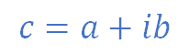
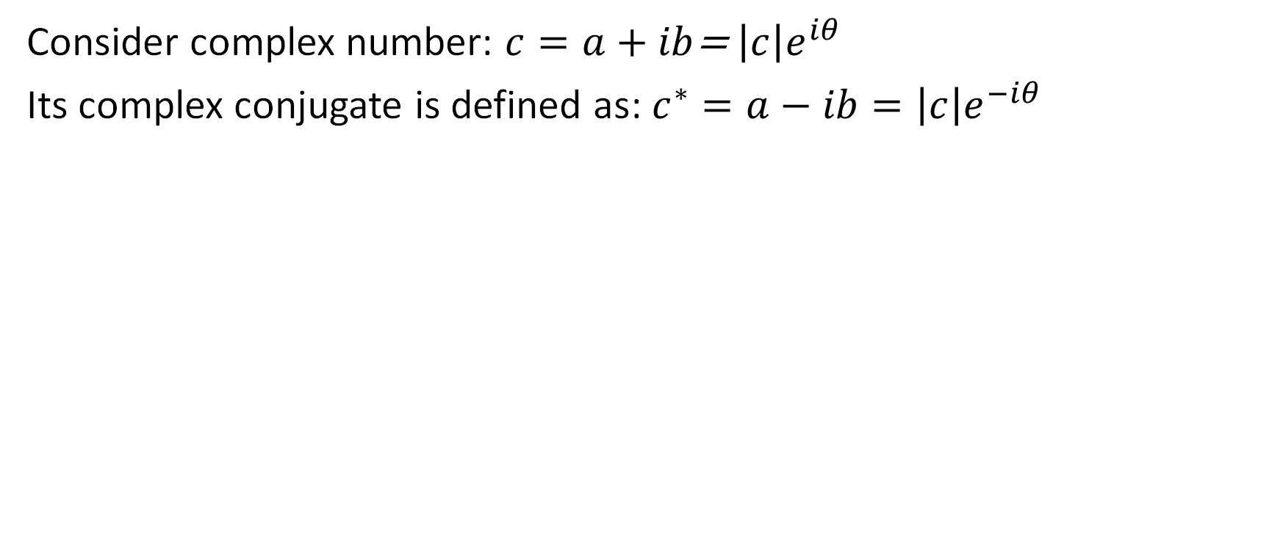
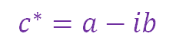
Useful expressions
Consider complex number: $c=a+ib$= $\left|c\right|e^{iθ}$
Its complex conjugate is defined as: $c^{∗}=a−ib=\left|c\right|e^{−iθ}$
Im
$$c=a+ib$$
Re
$$c^{∗}=a−ib$$

Slide 7
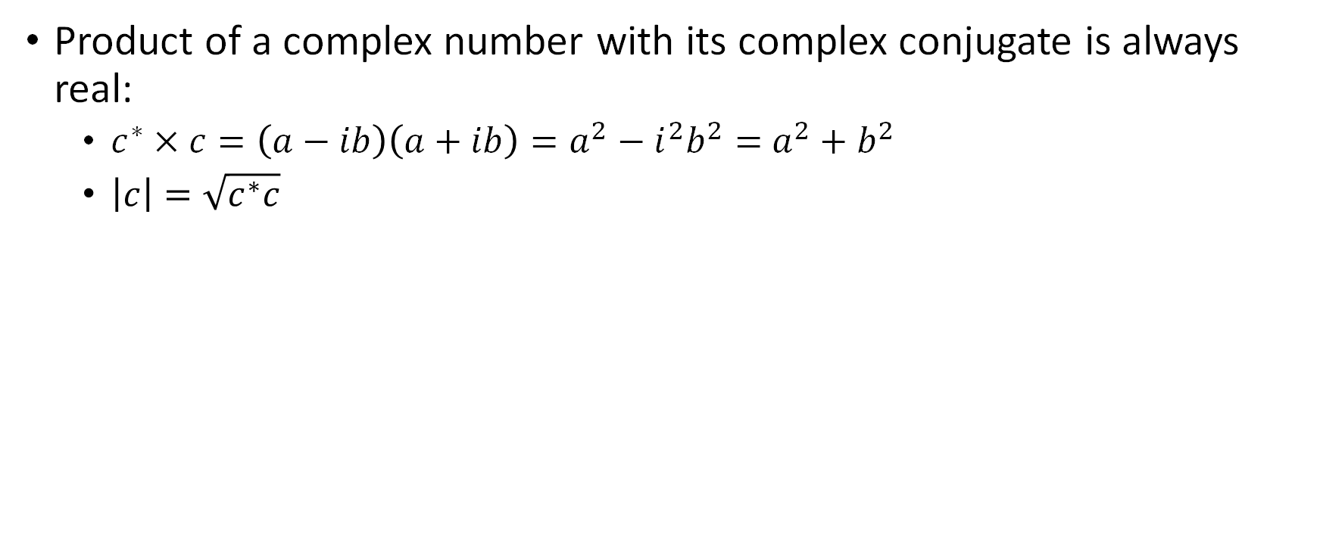
Useful expressions
Consider complex number: $c=a+ib$= $\left|c\right|e^{iθ}$
Its complex conjugate is defined as: $c^{∗}=a−ib=\left|c\right|e^{−iθ}$
Product of a complex number with its complex conjugate is always real:
$c^{∗}×c=\left(a−ib\right)\left(a+ib\right)=a^{2}−i^{2}b^{2}=$ $a^{2}+b^{2}$
$\left|c\right|=\sqrt{c^{∗}c}$

Slide 8
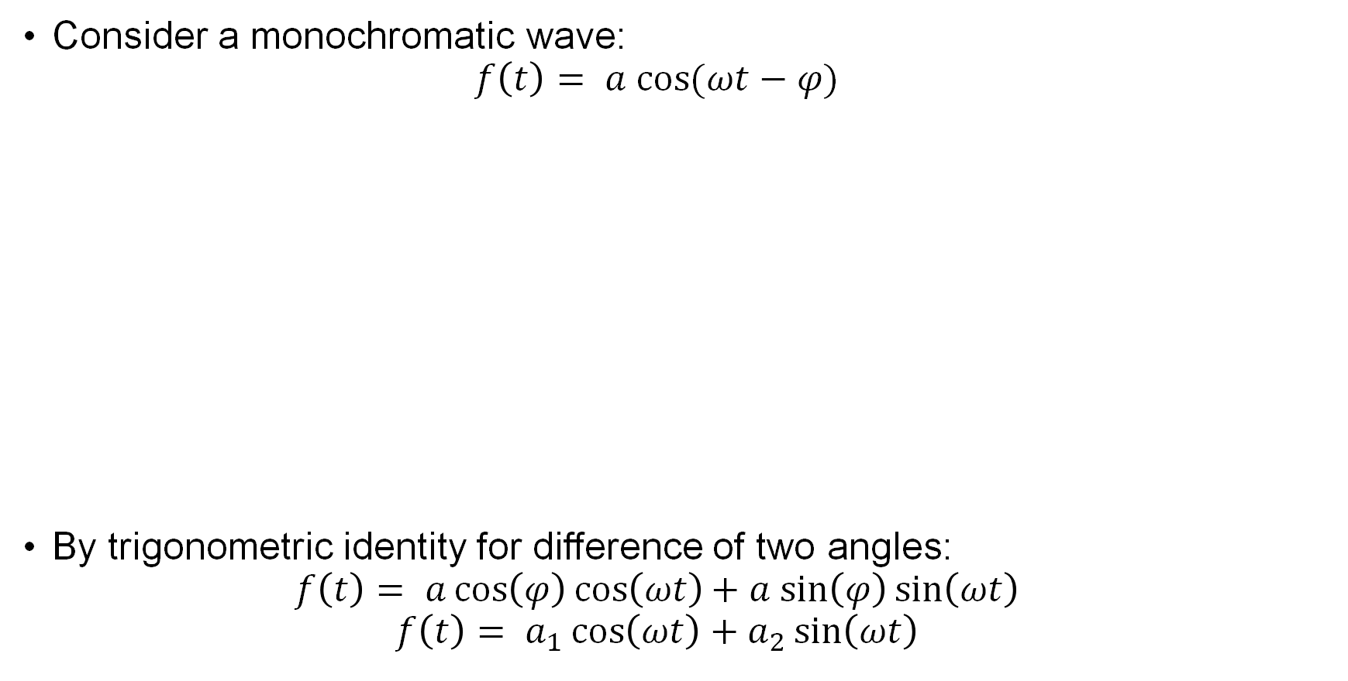
Amplitude and phase
Consider a monochromatic wave:
$$f\left(t\right)= a cos⁡(ωt−φ)$$
By trigonometric identity for difference of two angles:
$$f\left(t\right)= a\cos\left(φ\right)\cos\left(ωt\right)+ a sin\left(φ\right)\sin\left(ωt\right)$$
$$f\left(t\right)= a_{1}\cos\left(ωt\right)+a_{2}\sin\left(ωt\right)$$

Slide 9
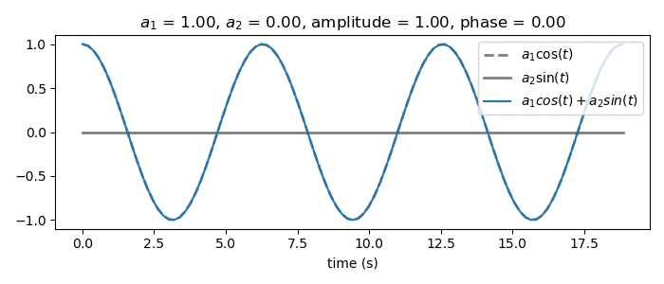
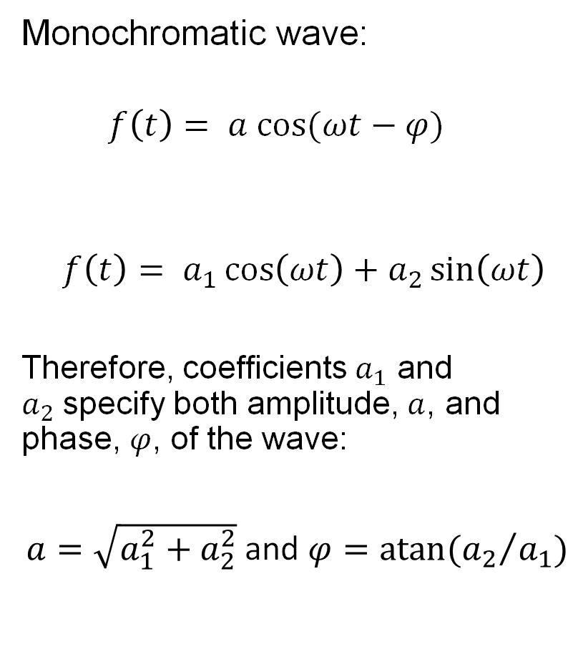
Amplitude and phase
Monochromatic wave:
$$f\left(t\right)= a cos⁡(ωt−φ)$$
$$f\left(t\right)= a_{1}\cos\left(ωt\right)+a_{2}\sin\left(ωt\right)$$
Therefore, coefficients $a_{1}$ and $a_{2}$specify both amplitude, $a$, and phase, $φ$, of the wave:
$a=\sqrt{a_{1}^{2}+a_{2}^{2}}$ and $φ=atan⁡({a_{2}}/{a_{1}})$

Slide 10
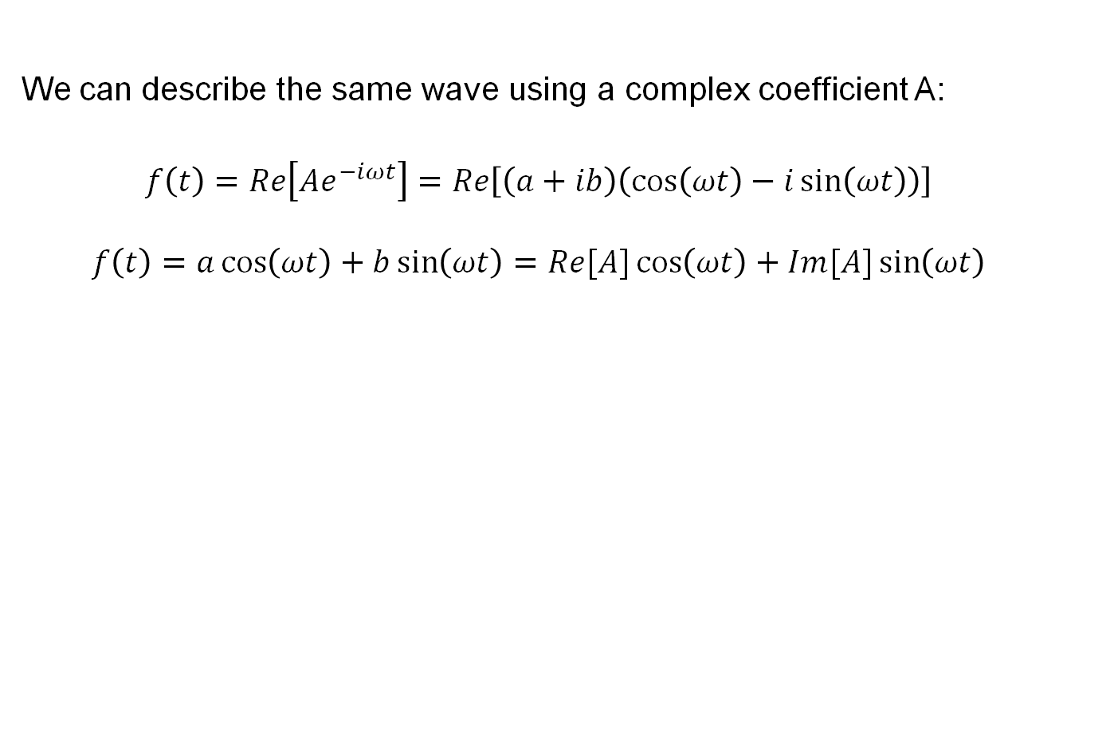
Complex coefficients
We can describe the same wave using a complex coefficient A:
$$f\left(t\right)=Re\left[{Ae}^{−iωt}\right]=Re\left[\left(a+ib\right)\left(\cos\left(ωt\right)−i\sin\left(ωt\right)\right)\right]$$
$$f\left(t\right)=a\cos\left(ωt\right)+b\sin\left(ωt\right)=Re[A]\cos\left(ωt\right)+Im[A]\sin\left(ωt\right)$$
Often, Re{} is left out, but it’s there

Slide 11
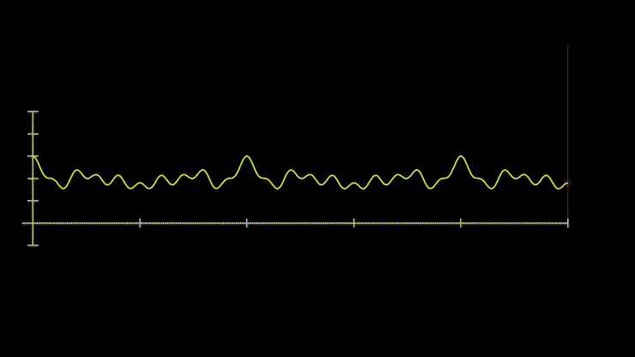
Fourier series
Any signal can be described by a summation of harmonic waves
Nice visual introduction to Fourier analysis:
https://www.3blue1brown.com/lessons/fourier-transforms

Slide 12
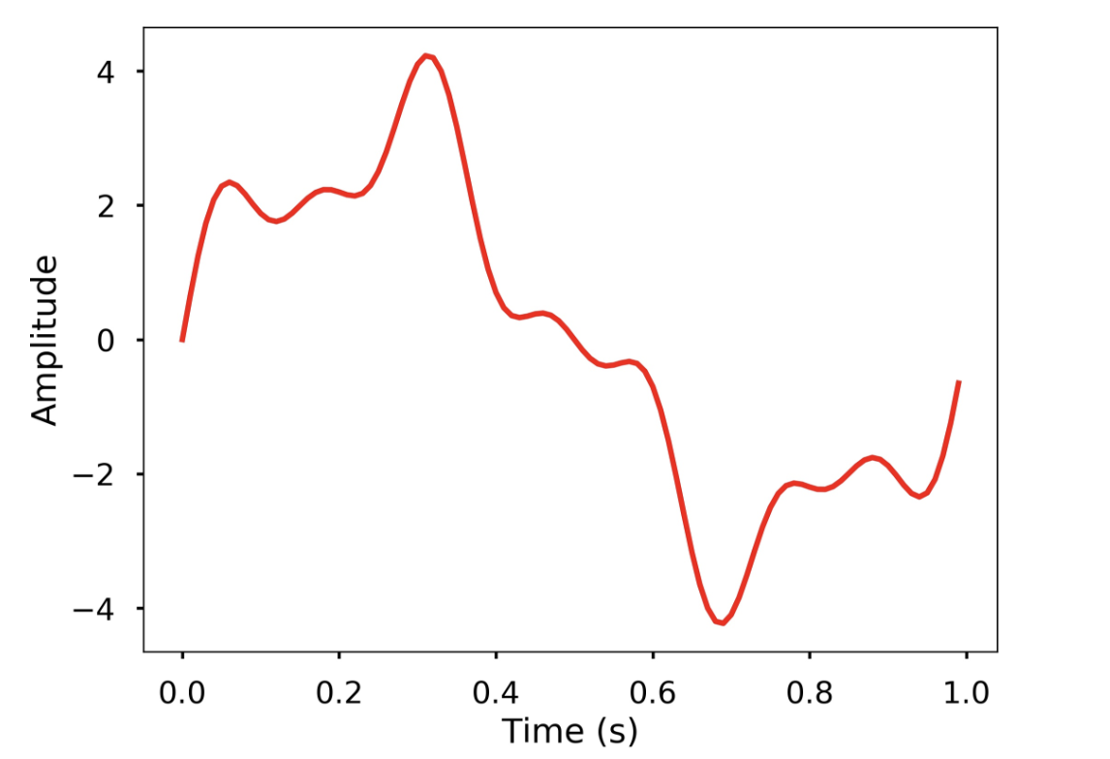
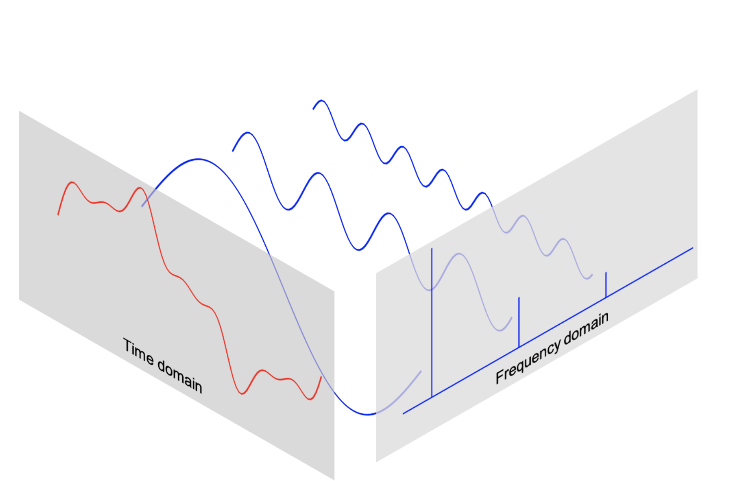
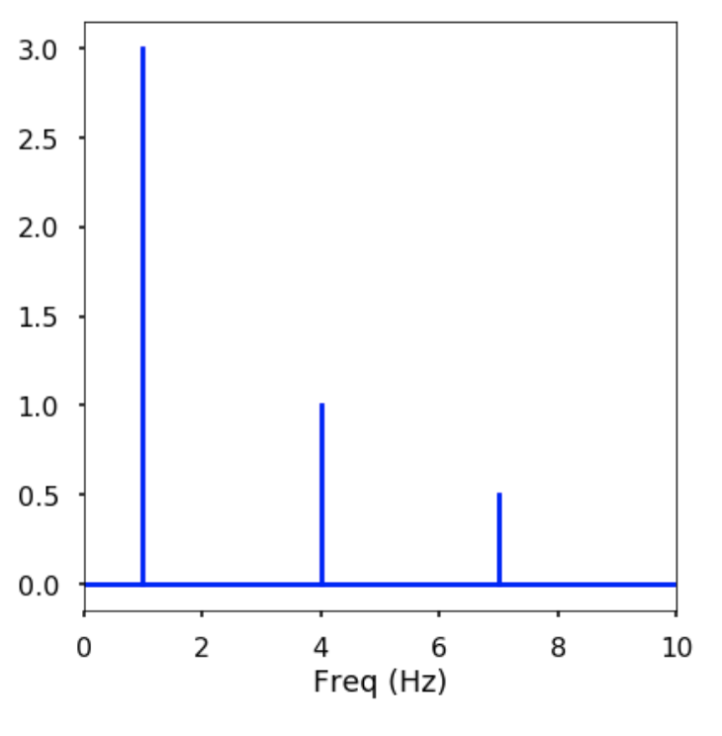
Fourier transform

Slide 13
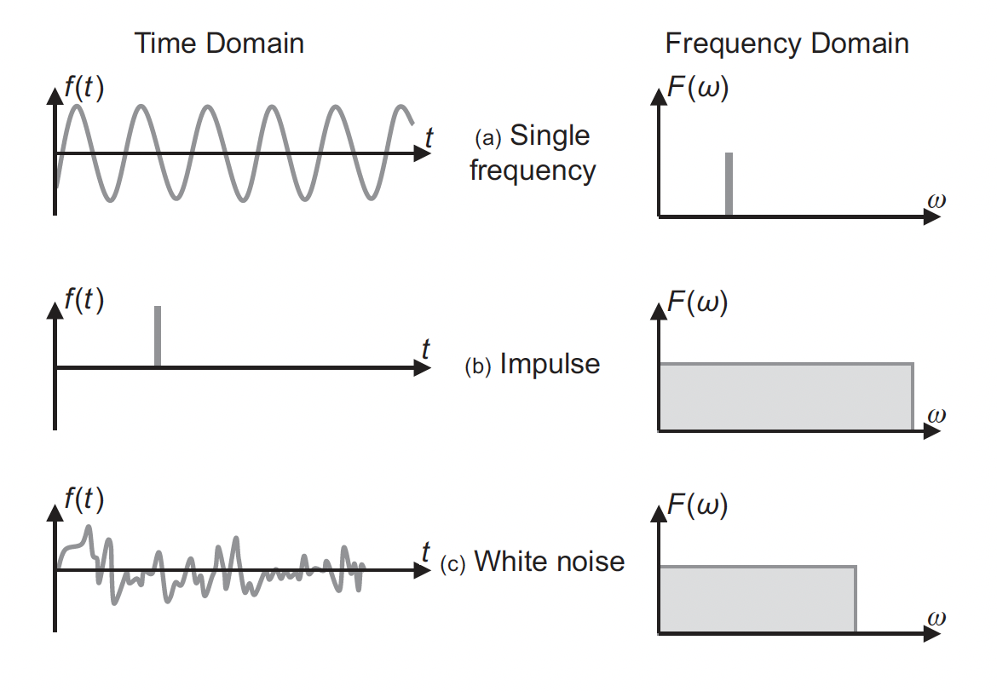
Amplitude/ phase spectrum
Amplitude spectrum:
Phase spectrum:
From Zhou (2014), Practical Seismic Data Analysis

Slide 14
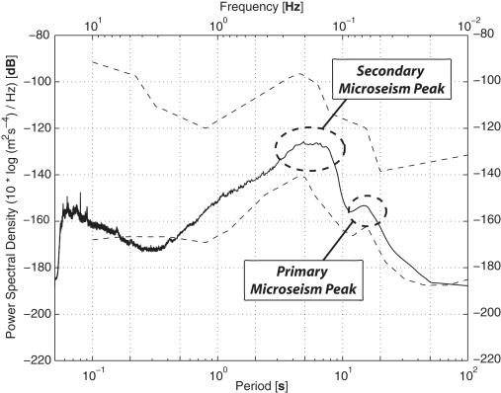
Power spectrum
Power spectrum of $F\left(ω\right)$ = | $F\left(ω\right)$ |²
*Typically, the reference value is 1

Slide 15
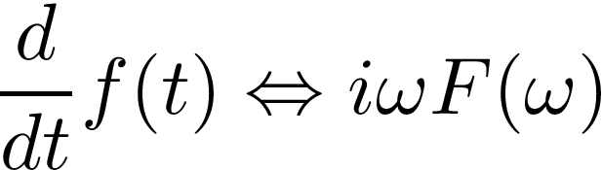
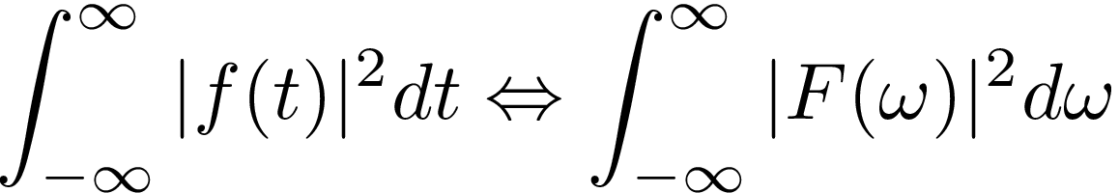
Properties of the Fourier Transform
Differentiation
FT
FT
Convolution
FT
Time shift
Parseval’s theorem
FT

Slide 16
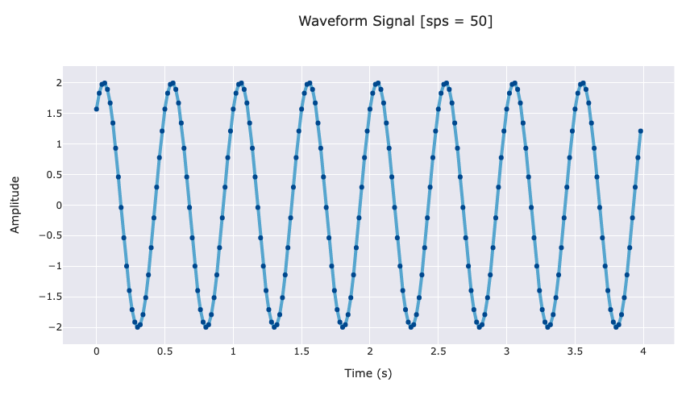
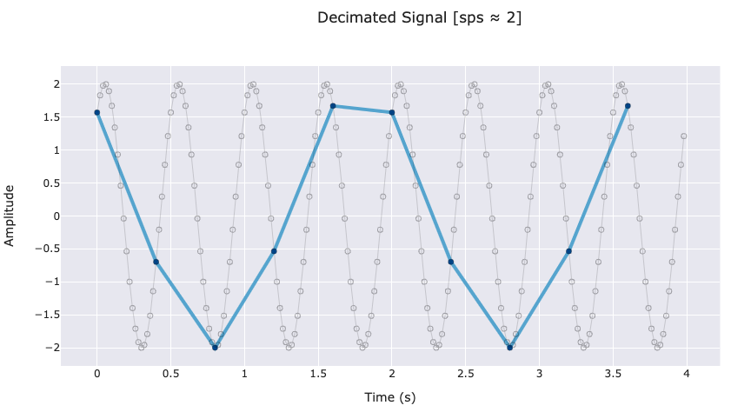
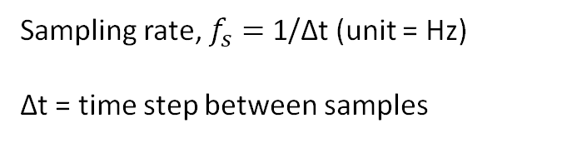
Digital signals and sampling
Sampling rate, $f_{s}=$1/∆t (unit = Hz)
∆t = time step between samples
When the sampling rate is not high enough, aliasing can occur.
To adequately sample a signal, we require at least 2 points per wavelength cycle

Slide 17
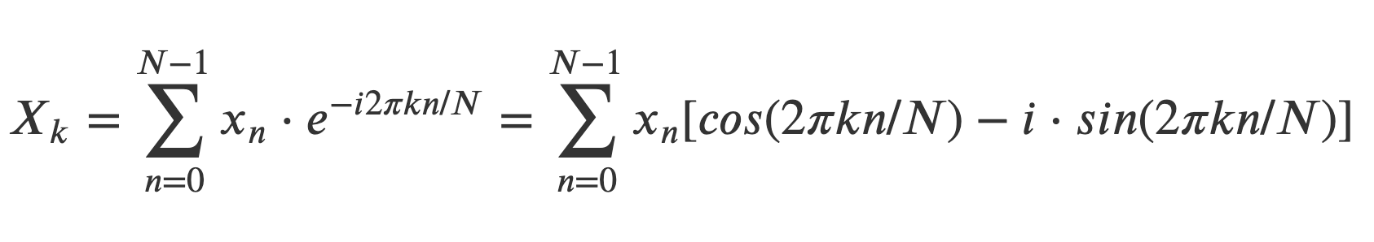
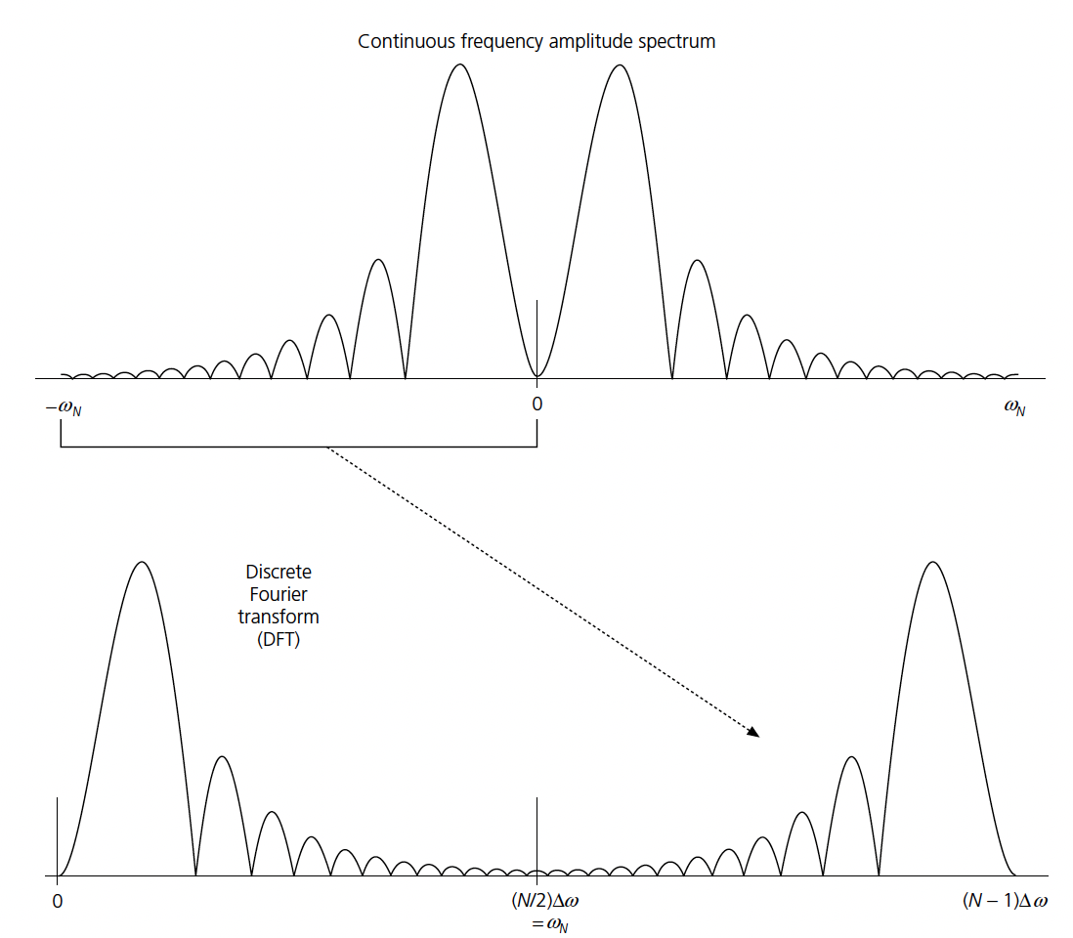
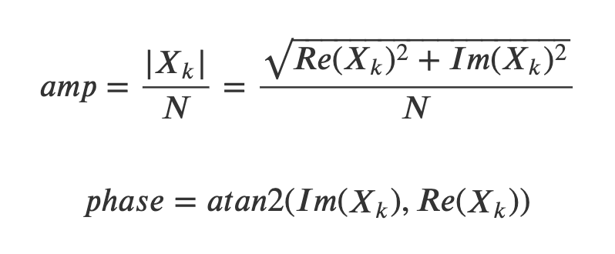
Discrete Fourier Transform
What does negative frequency mean?
From Stein and Wysession, 2003

Slide 18
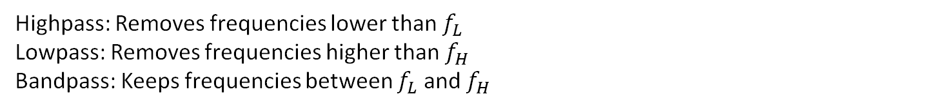
Digital filters
Highpass: Removes frequencies lower than $f_{L}$
Lowpass: Removes frequencies higher than $f_{H}$
Bandpass: Keeps frequencies between $f_{L}$ and $f_{H}$

Slide 19
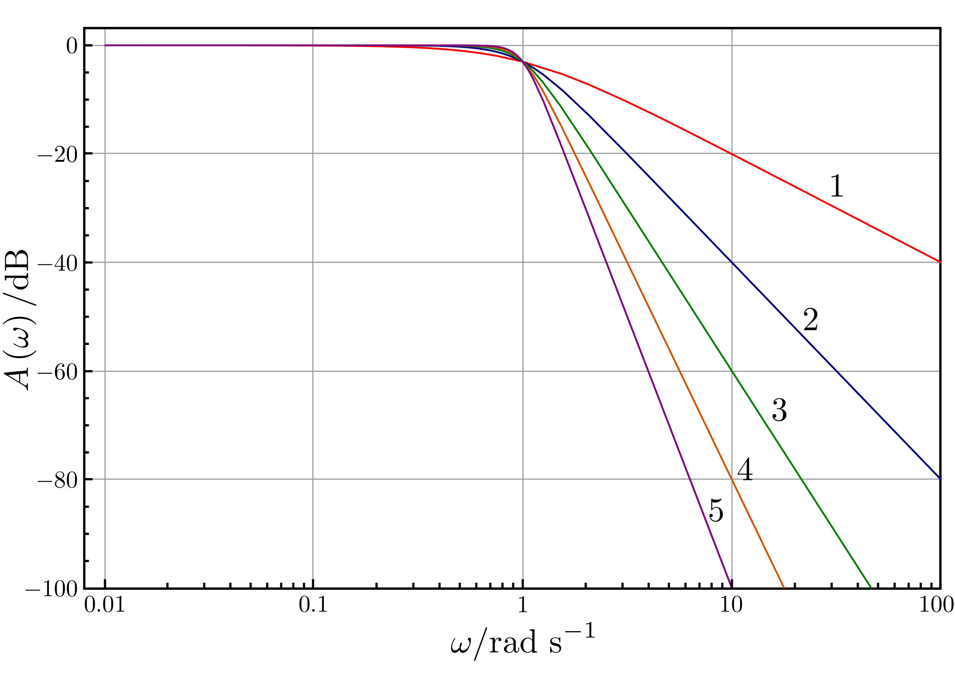
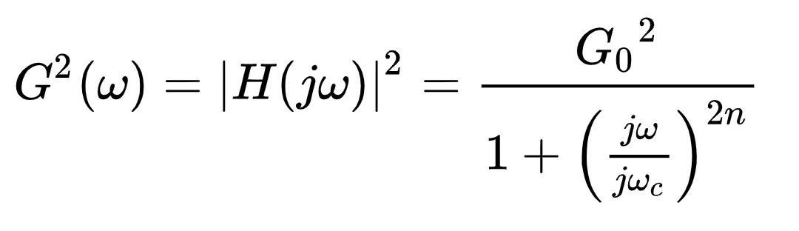
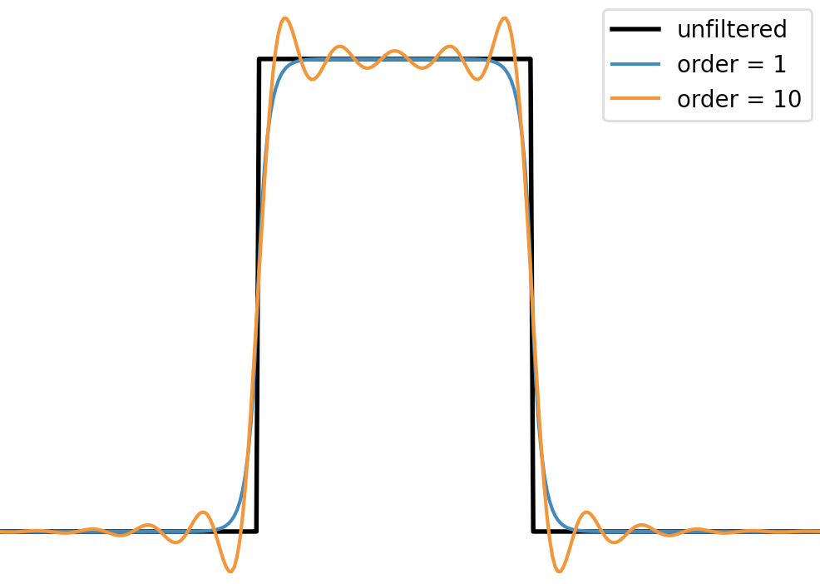
Filter design/ order
Butterworth filter
“ringing” artifact
(Gibbs phenomenon)

Slide 20
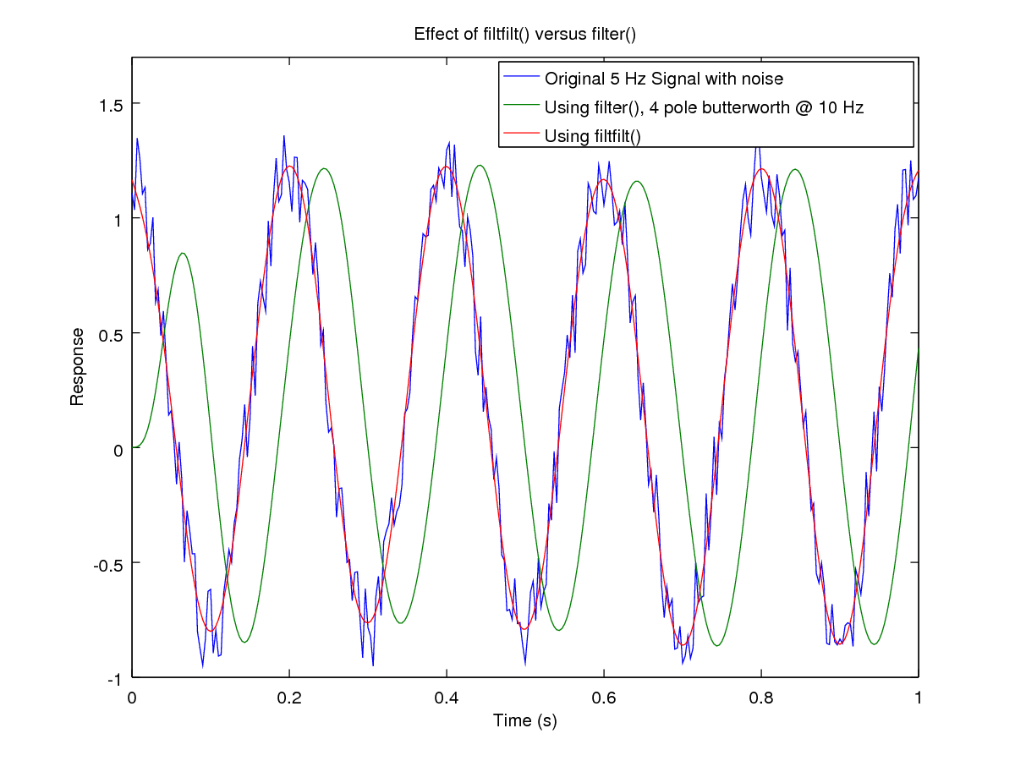
Causal vs acausal filters
Causal filter: output depends only on past and present input (can be used real time)
Acausal filter: “symmetric”, output depends on future input also.
http://www.mechanicalvibration.com/filtfilt_Causal_versus_non_.html

Slide 21
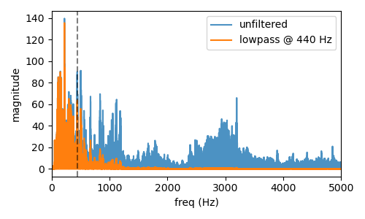

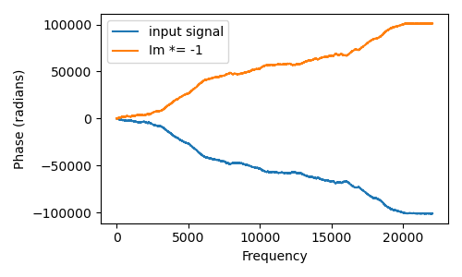

Fun with FFTs
Low pass filter, $f_{H}$ = 440 Hz
Complex conjugate of F(w)

Slide 22
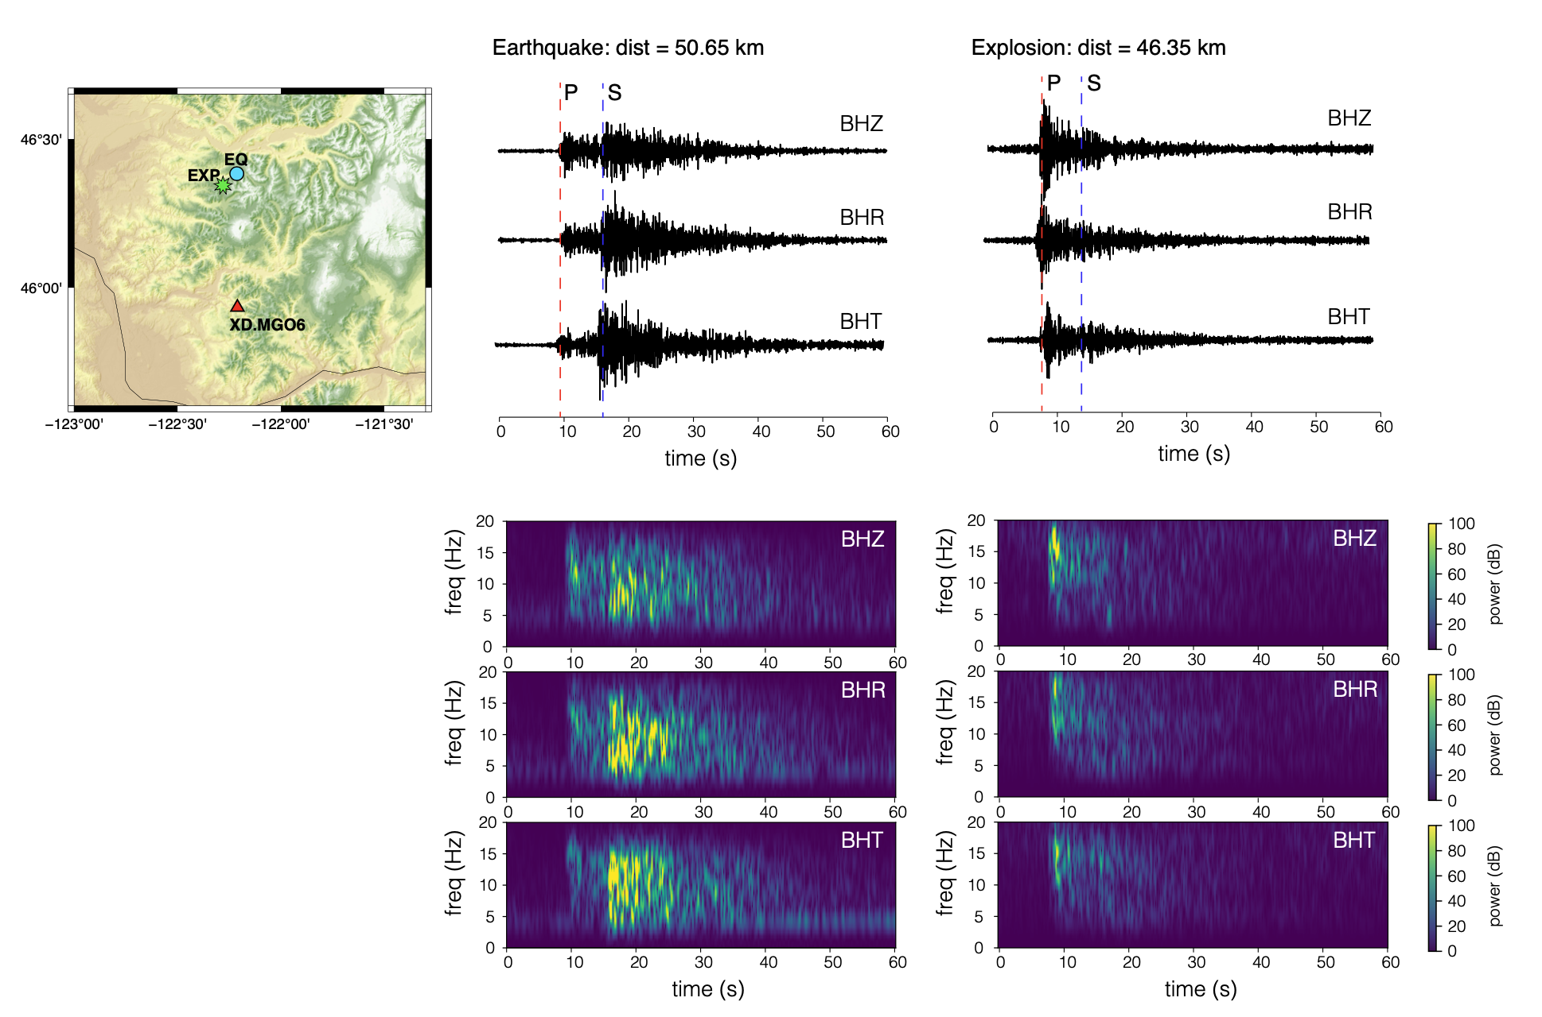
Spectrograms

Slide 23
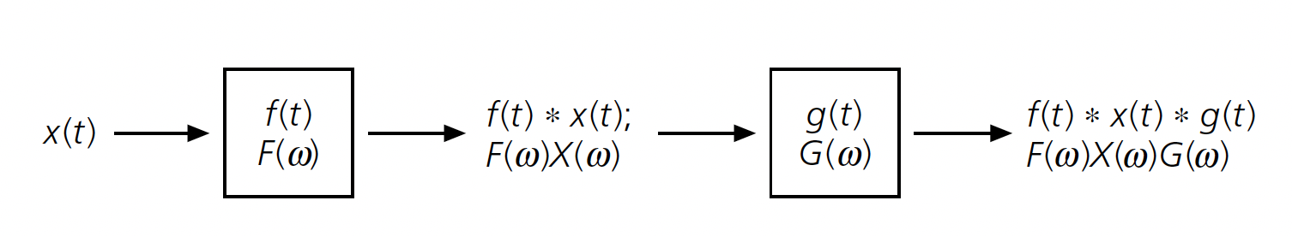
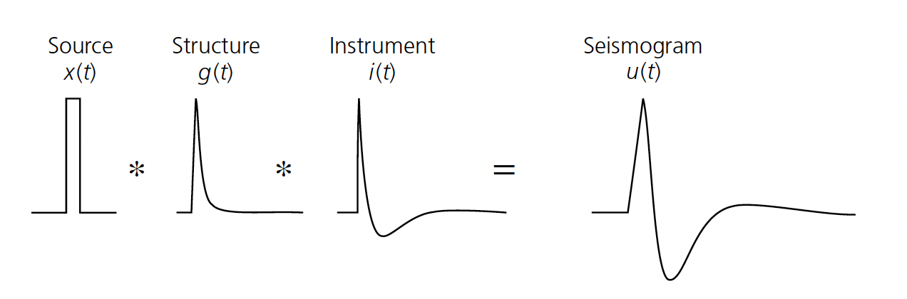
Convolution

Slide 24
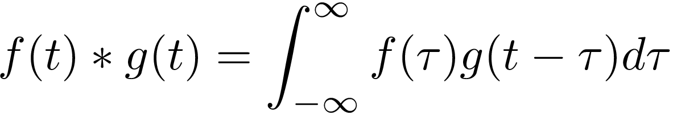

Convolution
Sometimes referred to as “sliding inner-product”

Slide 25
Convolution
Convolution in the time domain
Convolution in the time domain is equal to multiplication in the frequency domain

Slide 26
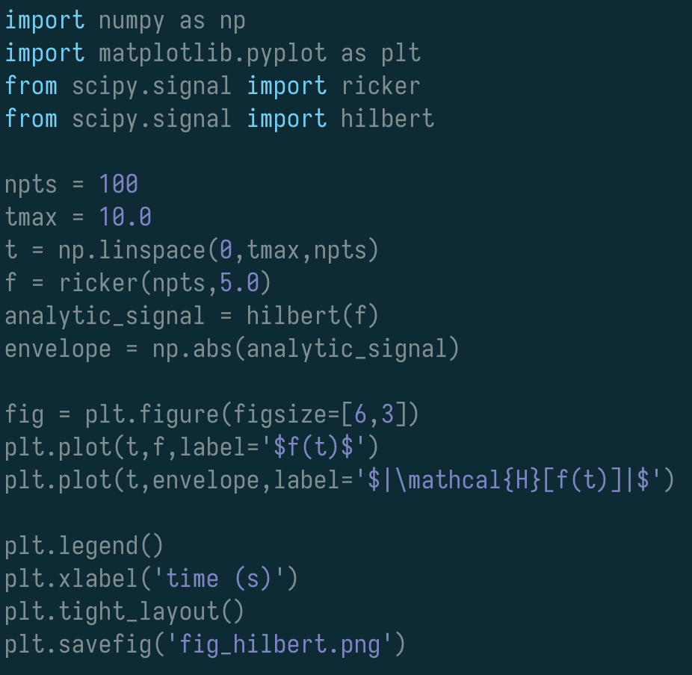
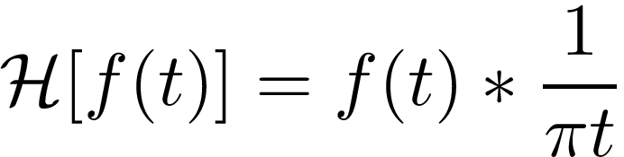
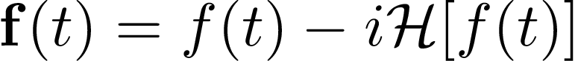
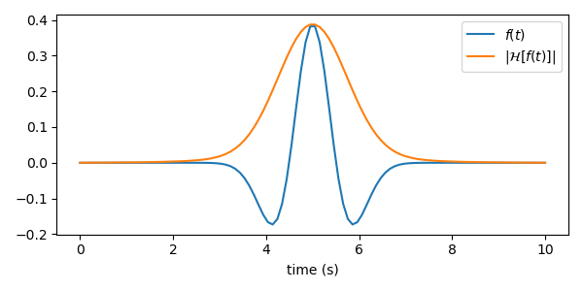
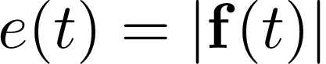
Hilbert transform
convolution of a signal with 1/pi*t
analytic signal
‘envelope’ of signal

Slide 27
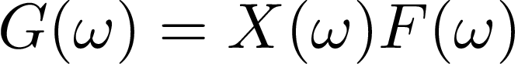
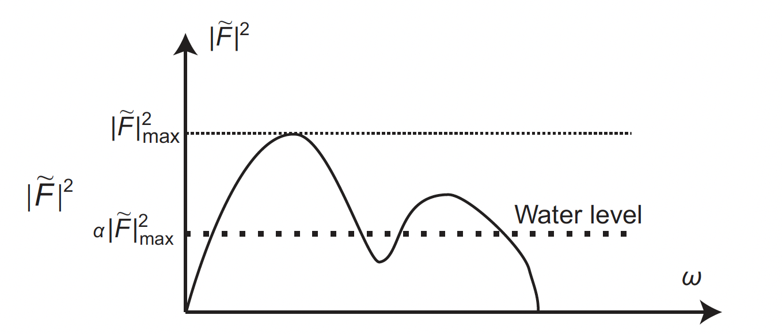
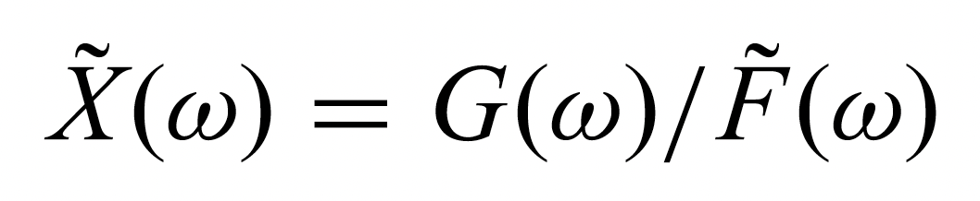
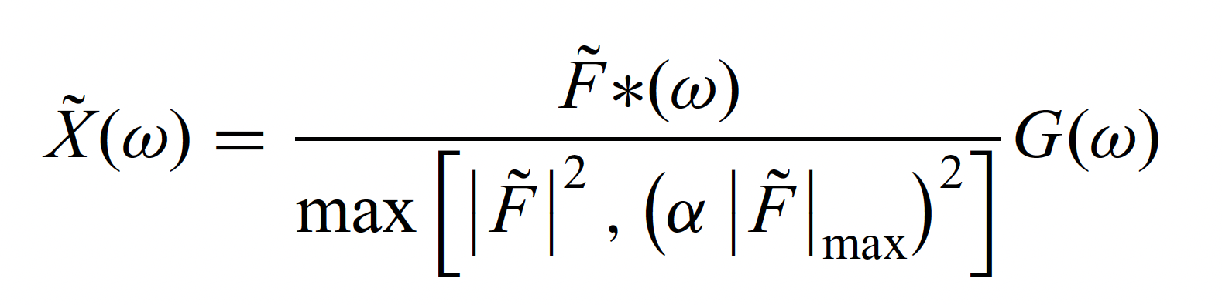
Deconvolution
seismogram
ground motion
instrument response

Slide 28
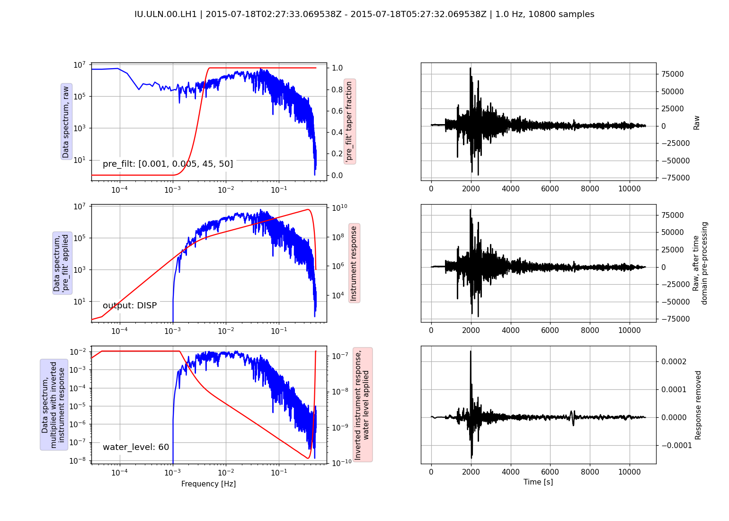
Removing the instrument response

Slide 29
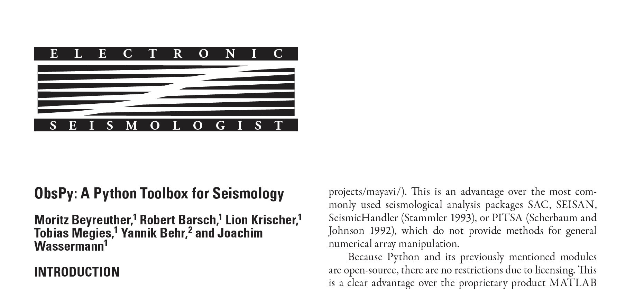
Obspy

